Slide 1
Project One
Project One | UNCC| Michael Riano

Slide 2
Primary Hypothesis
Does educational level correlate to how much salary one may take home in the Philippines?
My presuppositions are that yes, education matters and will impact how much one may or may not make.

Slide 3
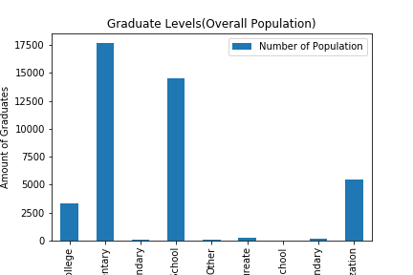
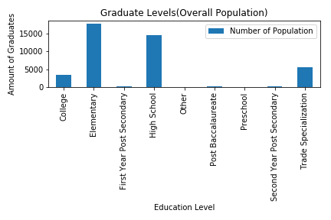
Graduate Levels

Slide 4
Graduate Level Analysis
The group with the highest education level throughout the Philippines has an elementary education level followed by being high school educated. The sample size of the population indicates that the mean age of the Filipino population presented in my data is between 50 and 55 years old. Being older the educational levels make sense. The graph in the next frame shows the 17 regions throughout the Philippines and average age within each region. This definitely has a correlation with the educational level being so low.

Slide 5
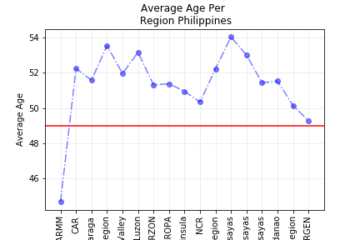
Average Age Graph

Slide 6
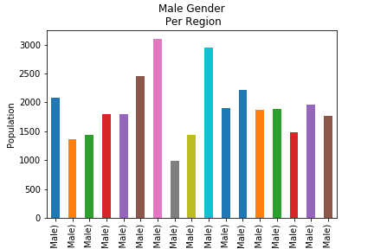
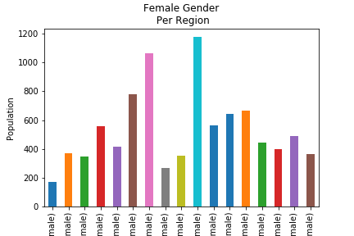
Gender per Region Male / Fmale

Slide 7
Gender Per Region Analysis
The gender per region analysis indicates there is a much heavier male population per region than female. Per the Pew Research Institute, females are more prone to be educated then men and will continue to into the future. This could be a causation for the lack of education.
See: http://www.pewresearch.org/fact-tank/2018/03/15/for-womens-history-month-a-look-at-gender-gains-and-gaps-in-the-u-s/ft_18-03-15_gendergains_womenarenow/

Slide 8
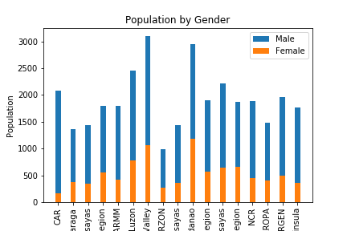
Gender Comparison Graph Unified

Slide 9
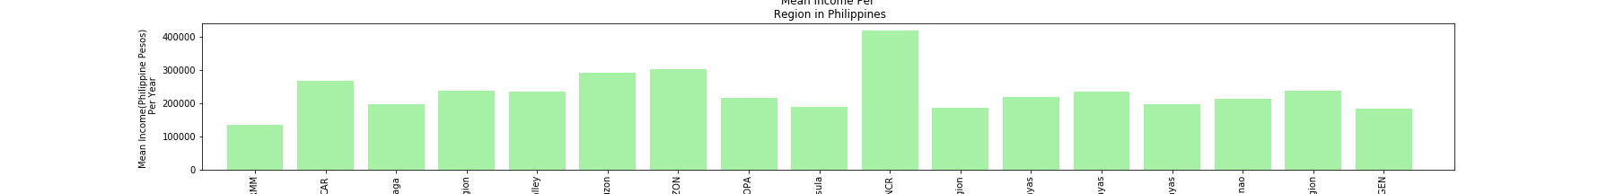
Average Income in the Philippines per Region

Slide 10
Average Income Review
The highest region’s income is the NCR or national capital region where Manila resides. This makes sense as most of the business is directed out of there. The average income is 400,000 PHP per year which equates to a USD rate yearly of $7518. This lack of income could directly correlate with the low educational standards that have been presented via the data.

Slide 11
Final Conclusion
Educational level has impacted the Philippines and is shown in how the nation’s national wages are, including that in the region with the highest income.
Based on the dataset, the average Filipino is ~50 year old male. Gender inequalities do not seem to have an impact directly via the data presented.
It is mindful to remember that the Philippines is a 3rd world county and should not be compared to stats of that from the U.S.

